Slide 1
Module 2 – Leadership
Unit 1 Overview - Leadership
(Slides 1-8)

Slide 2
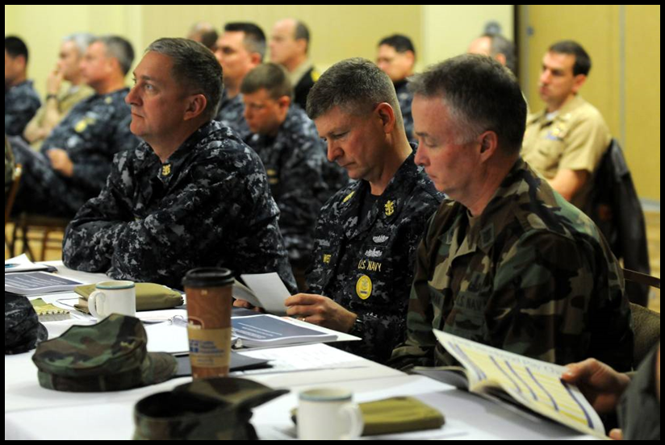
Unit Overview
Leadership can be defined as an art, gift or science by which a person can direct the thoughts, plans and actions of others in order to obtain their:
Obedience
Respect
Confidence
Loyal cooperation

Slide 3
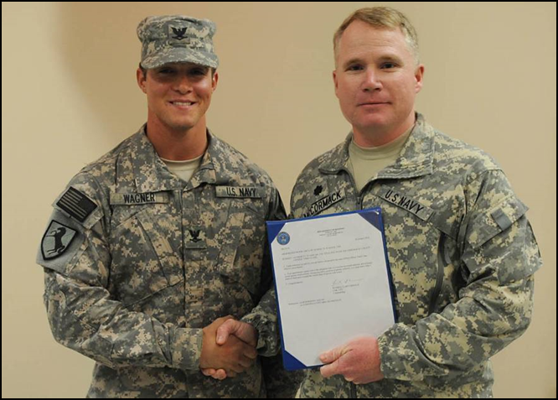
Unit Overview
The effective leader:
Understands the challenge of leadership
Embodies the desired qualities of a leader
Satisfactorily evaluates performance of self and subordinates
Knows how to deliver instruction

Slide 4
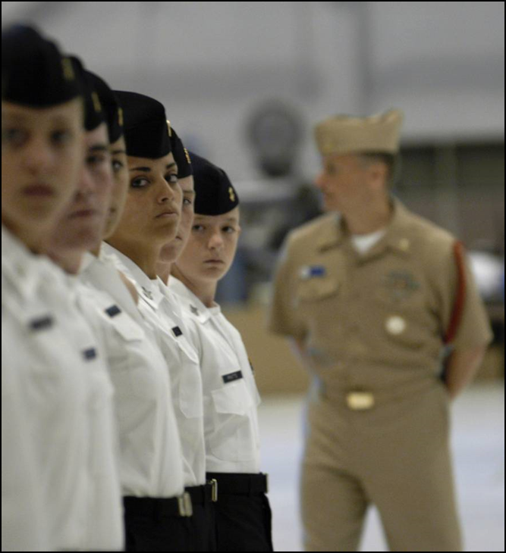
Unit Overview
Although the circumstances of each leadership position may be unique, the challenge of leadership remains the same…
To get people to do the job effectively

Slide 5
Unit Overview
The same qualities that make a good leader in the military services are equally helpful to the civilian leader….
Moral responsibility
Loyalty and devotion to duty
Professional knowledge
Self-confidence
Initiative and ingenuity
Courage and moral courage
Ability to organize
Discipline and self-discipline
Ability to make decisions

Slide 6
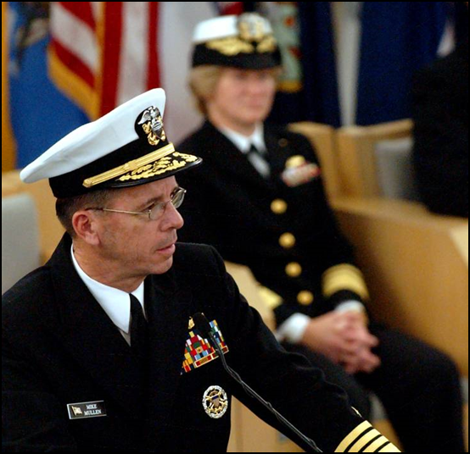
Unit Overview
NJROTC cadet officers immediately become concerned with the selection of personnel for leadership positions for advancement, for filling billets in the organization and for carrying out specific assignments.
The overall performance rating of a naval leader is affected by his or her ability to select appropriate people for various roles, and to appraise objectively their future capabilities in more responsible assignments.

Slide 7
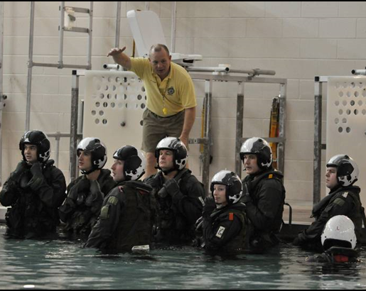
Unit Overview
As you become an upperclassman in your school and achieve higher ranks within your NJROTC unit, you will often be called upon to give either formal or informal instruction to schoolmates or to junior NJROTC cadets.
To effectively give instruction, you need to know:
Some learning theory
How to prepare for instruction
Techniques for delivery

Slide 8
Unit Overview
The following topics will be covered in this unit:
The Challenge of Leadership
Qualities of a Leader
Evaluation of Performance
How to Give Instruction

Slide 9
Module 2 – Leadership
Unit 1 - Leadership
Chapter 1 – The Challenge of Leadership
Section 1 – The Challenge of Leadership

Slide 10
Demonstrate knowledge of the challenge of leadership, the qualities of an effective leader, how to evaluate the performance of subordinates and how to give instruction

Slide 11
Describe the basis for effective leadership
Explain the differences in philosophies of leadership
Explain the importance of obedience
Describe obedience in the military services
Describe the legal and moral obligations of military leaders
Summarize the challenge of leadership

Slide 12
Key Term Questions Slide Index
Click any link below to go directly to polling that question.
Status of deserving praise, blame, reward, or punishment
Response to order allowing some personal initiative
Automatic response to order
Directive to action of some kind
Calls for blind obedience; very specific order
Click here to return to this index.

Slide 13
Team Assignment
Alpha
Bravo
Charlie
Delta

Slide 14
The status of deserving praise, blame, reward, or punishment for an act or omission, in accordance with one's ethical obligations
Principled responsibility
Moral obedience
Moral responsibility
Blind obedience
0
1
2
1
(NS3-M2U1C1S1:KT1)

Slide 15
Response to an order allowing some personal initiative in carrying out the order
Commanded obedience
Blind obedience
Responsible obedience
Reasoned obedience
2
0
1
1
(NS3-M2U1C1S1:KT2)

Slide 16
Automatic response to order such as commands issued during close order drill or steering commands to a helmsman
Reasoned obedience
Blind obedience
Responsible obedience
Commanded obedience
0
3
0
1
(NS3-M2U1C1S1:KT3)

Slide 17
A directive to action of some kind, generally given by a senior to a junior
Summons
Order
Mandate
Memorandum
0
3
1
0
(NS3-M2U1C1S1:KT4)

Slide 18
Calls for blind obedience and is a very specific order
Summons
Decree
Command
Memorandum
0
0
4
0
(NS3-M2U1C1S1:KT5)

Slide 19
Moral
The status of morally deserving praise,
responsibility
-
blame, reward or punishment for an act
or omission, in accordance with one’s
moral obligations
Reasoned
Response to an order allowing some
obedience
-
personal initiative in carrying out the
order

Slide 20
Blind
Automatic response to orders such as
obedience
-
commands issued during close order
drill or steering commands to a
helmsman
Order
-
A directive to action of some kind,
generally given by a senior to a junior
Command
-
Calls for blind obedience and is a very
specific order

Slide 21
Why is it important to know the difference between an order and a command?
1.
2.
3.
Note to Instructors:
Click the Show/Hide Response Display Button

Slide 22
How often do you find yourself leading others?
Constantly - I always end up in leadership roles, be it social, academic, or professional.
Most of the time - Typically, I am leading others.
Sometimes - I haven’t had many opportunities.
Rarely - I am more of a follower. Say jump and I’ll ask, How high?
1
3
4
0
(NS3-M2U1C1S1:LQ1)

Slide 23
Poor leadership can cause mission failure.
True
False
(NS3-M2U1C1S1:LQ2)

Slide 24
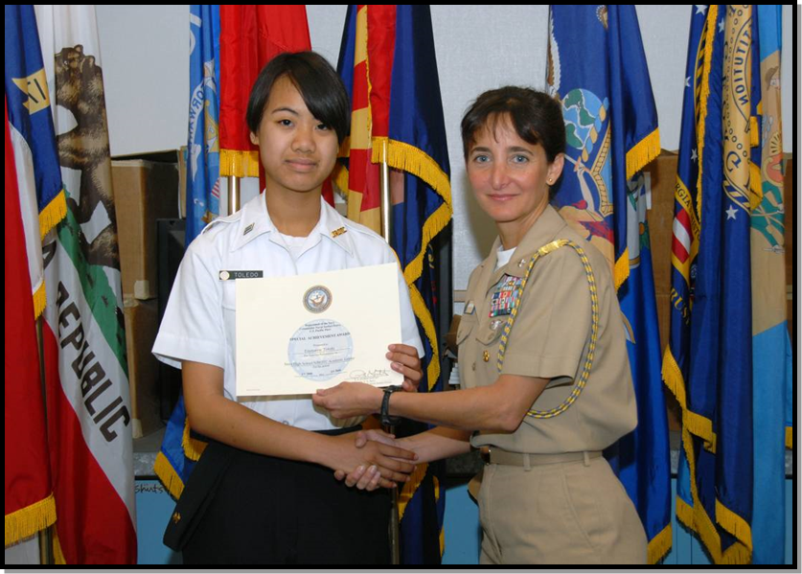
Introduction
Leaders and their Skills:
Leadership skills are important in military and civilian life.
Leaders are responsible for evaluating the performance of subordinates.
Effective leaders use effective instruction techniques.

Slide 25
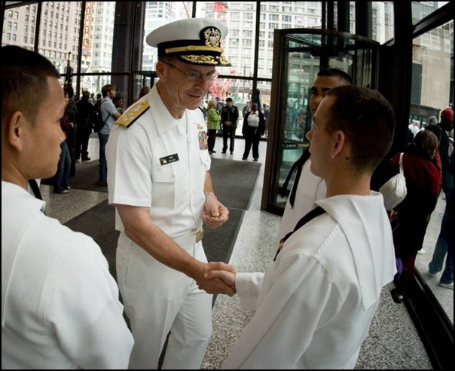
Basis for Effective Leadership
Good leaders inspire and manage groups of people.
Effective leadership is based on:
Personal example
Good organization and administration
Personal and moral responsibility
Leaders must learn to understand and value the people with whom they work.

Slide 26
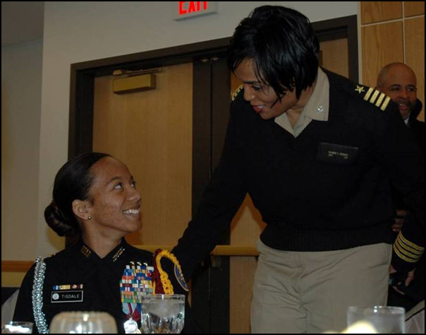
Basis for Effective Leadership
Good leaders understand…
How to act toward:
Seniors
Peers
Juniors
Philosophy of leadership based on firmly held moral values and integrity of character
Principles of good “followership”

Slide 27
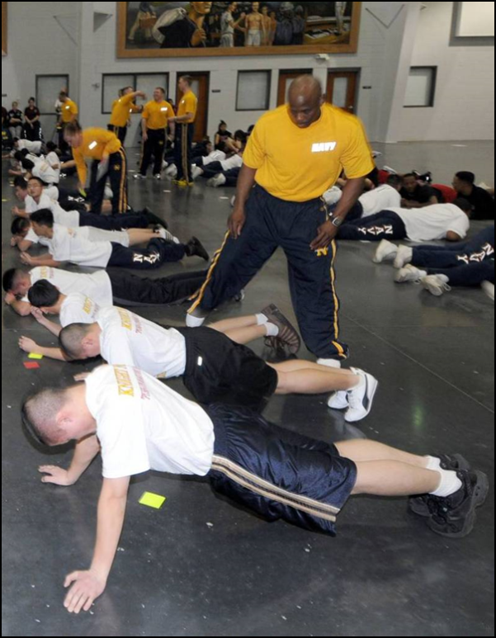
Basis for Effective Leadership
Good leaders also understand that…
Poor, ineffective leadership and administration can cause mission failure
To achieve the “power” of leader- ship, one must be willing to give up some personal time and material gain
It is important to walk before running, and to follow before leading

Slide 28
Philosophies of Leadership
There are widely differing philosophies regarding leadership, centered around these questions….
Are leaders born or made?
Can anyone who can master the principles of leadership effectively lead?
Is it a managerial process or a matter of character and moral development?
Can one learn to lead simply by studying the lives of the great ones?

Slide 29
Leaders must learn to ______ and ______ the people with whom they work.
use; abuse
understand; value
discipline; belittle
empathize; pity
0
7
0
0
(NS3-M2U1C1S1:LQ3)

Slide 30
Which of the following statements are true? (Input all that apply, then push the ENTER button.)
Leadership should be based on firmly held moral values.
Good leaders need to only understand how to act toward their juniors.
Good leaders must know principles that make for good followers.
Leadership skills are most important in military life.
Leaders are responsible for evaluating the performance of subordinates.
0
0
0
0
0
(NS3-M2U1C1S1:LQ4)

Slide 31
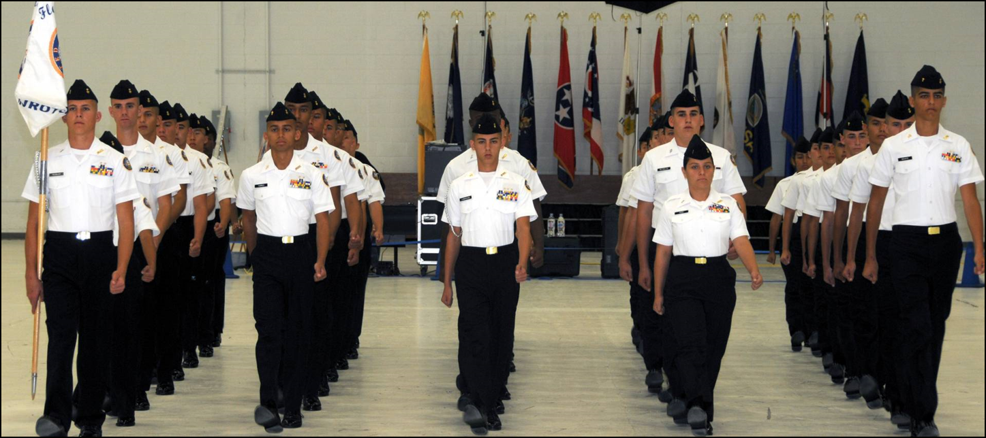
Obedience
Obedience is a necessary first lesson for all people, but it is especially critical for military people.

Slide 32
Obedience
The military product is defense of our country and our way of life.
This means that military service people must be more idealistic than the average citizen because they are serving, protecting, and defending the U.S. and its allies – even to the extent of death in peace or war.

Slide 33
Obedience
Enlisted personnel take an oath to carry out the lawful orders of those over them.
There are two forms of obedience in the military, each with its own time and place:
Blind obedience – automatic, no time to think
Reasoned obedience – not automatic, there is time to think

Slide 34
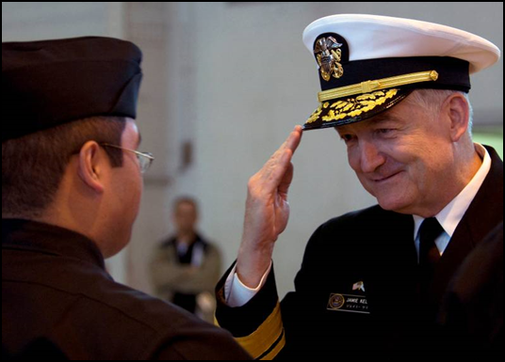
Obedience
Reasoned obedience is the most desirable form of obedience, because people learn and work best when allowed to use their own ideas.
Orders that call for reasoned obedience may be given in polite ways, such as “Please” or “Would you….?” These are still orders to obey, but reasonable questions and suggestions are welcome.

Slide 35
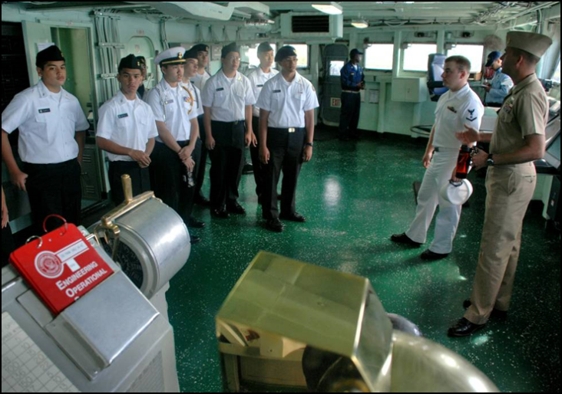
Obedience
A command is a specific type of order that calls for immediate blind obedience.
When a command is given, there is no time for hesitating or questioning.
Generally, courteous terms are not used when commands are given. Examples would be:
“Commence fire!”
“Abort landing!”
“Run!”

Slide 36
Obedience
Why do people obey?
Often it is because they hope for a reward such as:
A compliment
Praise
Recognition
Privilege
Sometimes people obey because they fear punishment such as:
Imprisonment
Loss of privilege
Extra duty

Slide 37
What are the two forms of obedience in the military? (Input the TWO best answers, then push the ENTER button.)
Learned
Civil
Blind
Reasoned
0
0
0
0
(NS3-M2U1C1S1:LQ5)

Slide 38
The leader of a ship orders the sailors to cease fire. What type of obedience does this leadership warrant?
Learned
Civil
Blind
Reasoned
0
0
6
3
(NS3-M2U1C1S1:LQ6)

Slide 39
A Military Leader: A Legal and Moral Obligation
Civilian Versus Military Leaders
Civilian | Military
Superior knowledge and experience | Legally and morally obliged to: Effectively lead subordinates Be responsible for welfare of subordinates
Strong character or personality
Not legally responsible for employees
Concern for well-being of others is primarily a moral choice | Held to a binding legal contract

Slide 40
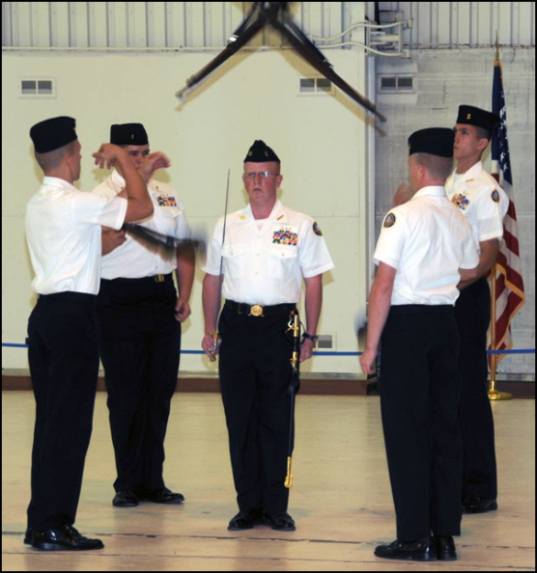
A Military Leader: A Legal and Moral Obligation
Military Leaders must:
Depend on subordinates
Know capabilities and limitations of subordinates
Be concerned with health, welfare and anything that affects peace of mind and efficiency on the job
Gain the confidence of personnel

Slide 41
The Challenge of Leadership
Disinterested persons and troublemakers are always present in groups.
Leaders guide and assist the disinterested to help them to:
Gain a sense of moral responsibility and importance to the team
Make life more pleasant and easier for all
Understand that more self-discipline equates to less discipline from leaders

Slide 42
The Challenge of Leadership
All should be led to understanding that learning, advancing in rate and assuming more responsibilities are duties of every Sailor and citizen, not just a choice of a select few.
Though each leadership position may be different, the challenge of leadership remains the same…
To get people to do the job.

Slide 43
Based on your own personality, how might you go about getting the cooperation of a disinterested or uncommitted subordinate?
1.
2.
3.
Note to Instructors:
Click the Show/Hide Response Display Button

Slide 44
What is the challenge and goal of every leadership position?
To advance in rank
To gain the most power
To delegate all responsibilities
To get people to do the job
0
0
0
0
(NS3-M2U1C1S1:LQ7)

Slide 45
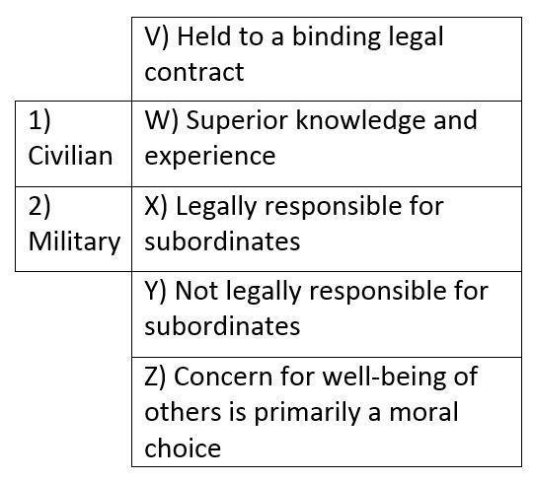
Choose the answer that best matches each item as either civilian or military leadership.
1) WYZ; 2) VX
1) WXZ; 2) VY
1) VX; 2) WYZ
1) WY; 2) VXZ
0
1
0
0
(NS3-M2U1C1S1:LQ8)

Slide 46
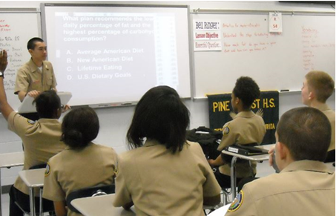

Slide 47
Leaderboard
Last
Slide
Points | Participant | Points | Participant

Slide 48
Team Scores
Last
Slide
Points | Team | Points | Team

Slide 49
Team MVP
Last
Slide
Points | Team | Participant

Slide 50
Whiteboard
Last
Slide

